Slide 1
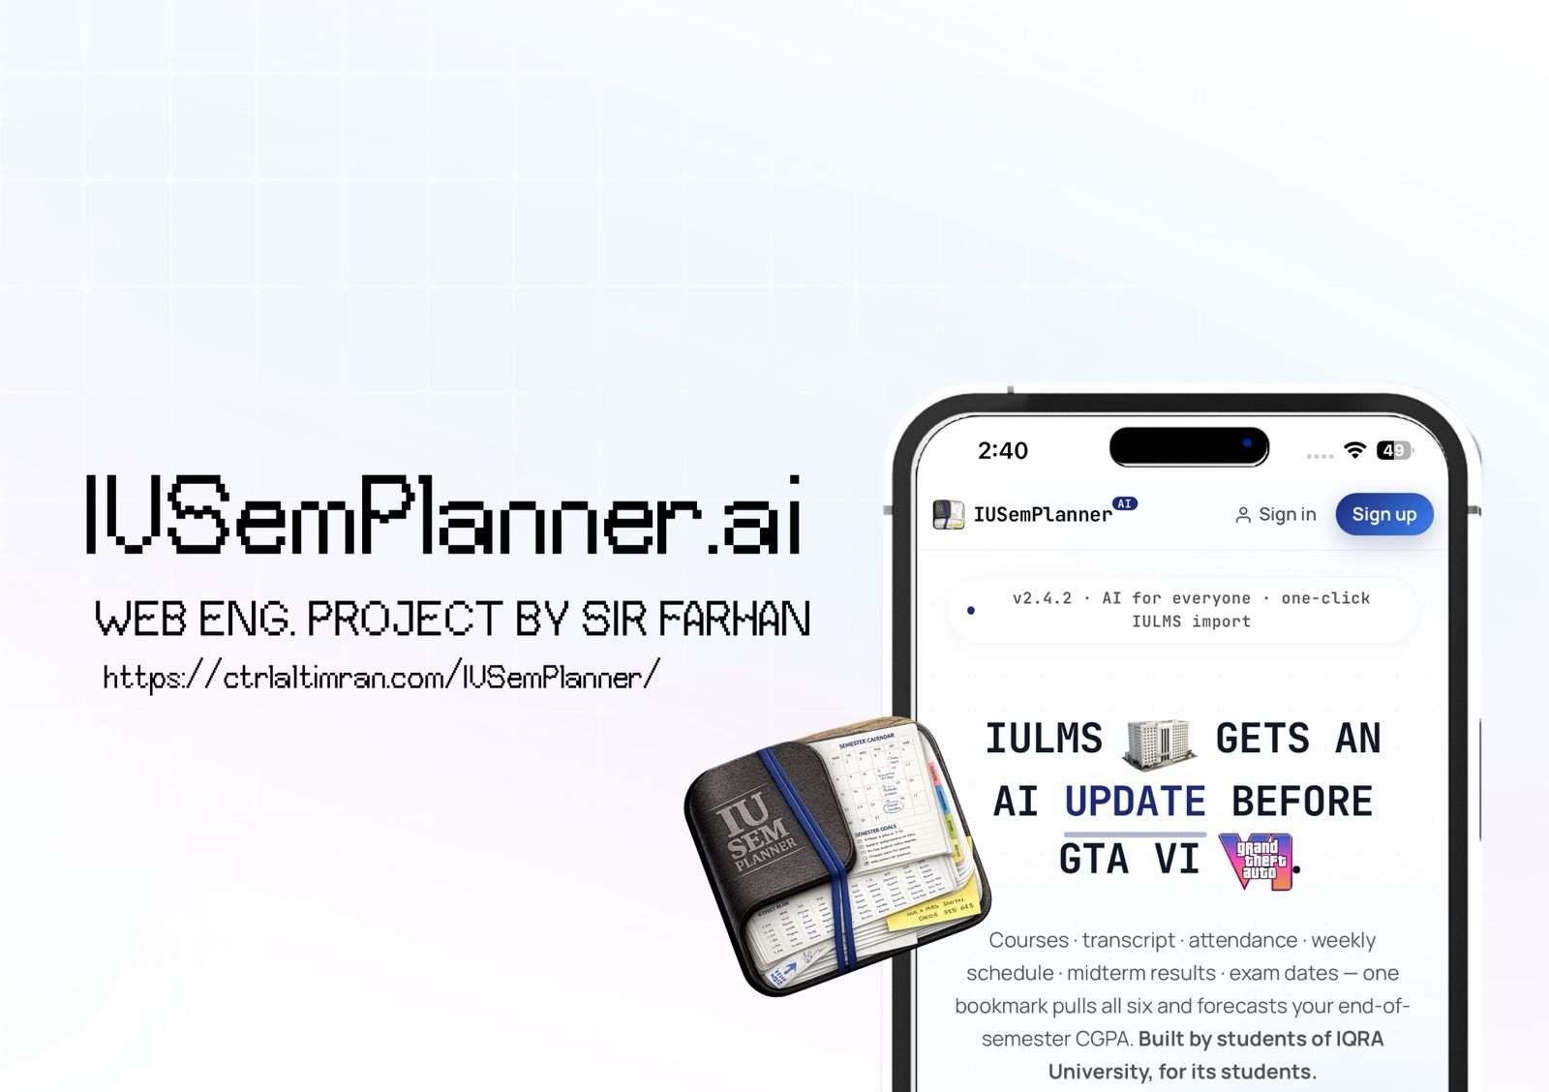

Slide 2
~/iqra-university/projects $
IUSemPlanner.ai
Predictive Student Dashboard for Iqra University
const project = "Academic planning + ANN prediction"
PROJECT TEAM
const stack = "HTML · CSS · Vanilla JS · Supabase"
Syed Imran Murtaza · 65196 Muhammad Raza · 63234 Instructor: Sir Muhammad Farhan
const ml = "Browser ANN + optional FastAPI"
const live = "ctrlaltimran.com/IUSemPlanner"
// 01 / 12

Slide 3
01 · CONTEXT
The Problem: Scattered Academic Data
At Iqra University, IULMS holds the data — but students must hop across many pages and calculate everything by hand.
%
Manual CGPA
!
Attendance risk
#
Clashing schedules
Students recalculate GPA & CGPA by hand — slow and error-prone.
Debar/attendance danger is noticed too late to fix.
Timetable clashes, long gaps & heavy days go unseen at registration.
?
Hidden prerequisites
>
Page hopping
x
Poor decisions
Unclear which completed courses unlock future ones.
Transcript, attendance, marks & exams live on separate IULMS pages.
Result: bad registration choices, burnout, missed risks.
// 02 / 12

Slide 4
02 · SOLUTION
One Smart Dashboard, One Click
A lightweight web app: log in to IULMS, run a bookmarklet, and raw academic data becomes cards, charts, warnings & predictions.
$ how-it-works
KEY OBJECTIVES
1. Open IUSemPlanner.ai (guest or login)
✓
Unify transcript, GPA, attendance, timetable & exams
2. Click bookmarklet inside IULMS
✓
Import IULMS data via one-click bookmarklet
3. Import profile · transcript · attendance
✓
Detect clashes, long gaps, empty & heavy days
✓
Predict semester GPA and projected CGPA
4. Save to localStorage (+ Supabase sync)
✓
Warn early on attendance & academic risk
5. Analytics + ML generate insights
✓
AI assistant answering from student's own context
6. Dashboard renders GPA · risk · plan
✓
Optional login + cloud sync across devices
// 03 / 12

Slide 5
03 · SCOPE
Scope of the System
A helper tool that reads the student's own data and presents it better — it does not replace the official IULMS portal.
✓ IN SCOPE
✕ OUT OF SCOPE
• Profile & transcript import from IULMS
• Does NOT modify official IULMS records
• Attendance tracking with risk labels
• Weekly timetable & current courses
• Does NOT register courses for the student
• Midterm + exam schedule import
• CGPA & semester GPA prediction
• ML trained on synthetic data, not real records (yet)
• Searchable course knowledge base
• Not an official university product (unless adopted)
• Planner: gap & clash detection
• AI summary, chat + Supabase cloud sync
Designed as an honest, supplementary academic-success tool.
// 04 / 12

Slide 6
04 · STACK
Technology Stack
Modern but lightweight — runs on plain static hosting, scales up to a VPS ML backend when needed.
Frontend
Logic
Auth
HTML5 · CSS3 · iOS-style
Vanilla JavaScript
Supabase Auth
Structure, responsive cards, tabs & mobile UI
State, parsing, rendering, analytics & ML engine
Email/password, sessions & Google OAuth
Database
Local
ML — Browser
Supabase PostgreSQL (JSONB)
Browser localStorage
Custom JS ANN (js/ml.js)
One JSON row of full app state per user
Instant guest-mode saving, works offline
Neural-network ensemble runs in the browser
ML — Backend
AI Module
FastAPI + scikit-learn
Provider JS AI calls
Optional /health & /predict on a VPS
Context-aware summaries, tips & chat
// 05 / 12

Slide 7
05 · ARCHITECTURE
System Architecture
A modular, client-first design. The frontend does the heavy lifting; Supabase and the FastAPI ML API are optional add-ons.
IULMS PORTAL
Official source of academic data
bookmarklet import
STATIC FRONTEND
STUDENT BROWSER
BROWSER ANN
index.html · styles.css · js/* modules
Runs app · stores state · executes bookmarklet · runs ANN
Default ML engine — no server required
SUPABASE
OPTIONAL FASTAPI ML
Auth (Google/email) + JSONB cloud sync
/health · /predict · scikit-learn
// 06 / 12
Dotted boxes are optional — app works fully offline in guest mode.

Slide 8
06 · FRONTEND
Frontend Design & Implementation
The largest part of the system — a tab-based dashboard where each tab serves a distinct academic need.
js/ — module map
Dashboard
Timetable
app.js state · auth · ML orchestration
Overview + warning cards
Weekly IULMS schedule
views.js renders tabs, modals & ML Lab
Progress
Transcript
parser.js parses IULMS payloads
Completed vs pending
Grades · credits · GPA
bookmarklet.js scrapes IULMS pages
analytics.js GPA · risk · gaps · clashes
Courses
Planner
ai.js builds context, calls AI
Searchable knowledge base
Gaps, clashes & decisions
ml.js browser ANN + VPS client
supabase.js cloud load / save
AI
ML/ANN Lab
Data-aware chat & summary
Neural grade predictor
// 07 / 12

Slide 9
07 · BACKEND + DATA
Backend & Database Design
Two backends: Supabase for accounts & storage, and an optional FastAPI service for ML. Data is stored as one JSON blob per user.
user_data — schema
FASTAPI ENDPOINTS
create table public.user_data (
GET /health → model info, MAE, engine POST /predict → 8 features → grade pts + uncertainty
user_id uuid primary key,
data jsonb not null,
updated_at timestamptz );
-- Row Level Security ON
WHY JSONB?
policy "read own" auth.uid()=user_id
• Data is user- and dashboard-specific
policy "insert own" with check (...)
• Keeps the database simple to manage
policy "update own" using (...)
• Add new fields without schema changes
• Frontend already holds full state as one blob
// 08 / 12

Slide 10
08 · MACHINE LEARNING
Machine Learning / ANN Module (v2.4)
A feed-forward Artificial Neural Network (MLP) predicts academic performance from current marks, attendance & history.
ARCHITECTURE
Adam backprop · 5-network ensemble · bootstrap starts
8
inputs
16
hidden · tanh
10
hidden · tanh
1
output · linear
8 INPUT FEATURES
PREDICTED OUTPUTS
› Midterm /20
› Quiz /10
✓ Expected grade points & letter grade
› Project /10
› Attendance %
✓ SGPA + projected CGPA
› Prior CGPA /4
› Credit hours
✓ Fail risk & attendance/debar risk
› Lab flag
› Course level
✓ Confidence score
✓ Occlusion-based explainability
// 09 / 12

Slide 11
09 · PRIVACY + TESTING
Security, Privacy & Validation
The app only reads the student's own data, never modifies IULMS, and is validated across modes & devices.
🔒 SECURITY & PRIVACY
✓ TESTING & VALIDATION
• Never changes official IULMS records
• Guest localStorage save works
• Guest mode: data stays in localStorage
• Email + Google OAuth sign-in
• Account mode: stored in user's own row
• Bookmarklet import on live IULMS
• Row Level Security isolates each user
• Parsing: transcript, attendance, exams
• Timetable clash & gap detection
• Anon public key is safe — RLS controls access
• Browser ML works with no backend
• ML API is stateless — no stored records
• FastAPI /health & /predict + fallback
• Public deploys need consent + data-delete
• Mobile responsiveness of all tabs
// 10 / 12

Slide 12
10 · ROADMAP
Limitations & Future Enhancements
⚠ CURRENT LIMITATIONS
🚀 FUTURE ENHANCEMENTS
• ML trains on synthetic, not real records
• Train ML on real (anonymized) records
• Accuracy improves with real history
• Admin panel + stronger prerequisite engine
• Bookmarklet depends on IULMS HTML
• PDF report export for students
• Attendance / exam / deadline reminders
• Not an official university system (yet)
• GPA, attendance & workload trend charts
• Advanced features need a VPS / serverless
• Delete-account & delete-data options
• AI quality depends on provider & data clarity
• PWA / mobile-app wrapper
// 11 / 12

Slide 13
$ ./conclusion --summary
A clearer view of every
student's semester.
IUSemPlanner.ai turns scattered IULMS data into smart, actionable guidance — combining import, clean dashboards, analytics, AI tips and ANN prediction. Realistic to deploy on static hosting, and ready to grow into a full student-success platform.
8
8
2
ANN input features
dashboard tabs
optional backends
Live: ctrlaltimran.com/IUSemPlanner · Iqra University · Sir Muhammad Farhan

